Slide 1

Artificial Intelligence: Applications to Pedagogical Course Content
Intern/Mentor Presentation
Esha Hegde

Slide 2
“The measure of intelligence is the ability to change.”
Intern/Mentor Presentation
- Albert Einstein

Slide 3

My Journey
Why:
Interest: Took a few courses (online!) on Python, data structures, etc; found the AI field very intriguing.
Diving Deeper: AI evidently can be applied to different fields such as healthcare, finance, government, etc.
Why not use it to revolutionize education?
How:
Internship Focus: Conduct market research, help develop product ideas and pitch strategies, test AI generated courses + contribute to software, and learn software concepts through reverse engineering existing code.
Goal: Understand how AI-generated courses compare to human-designed curricula and optimize them.
Intern/Mentor Presentation

Slide 4
Intern/Mentor Presentation
Background History
1960s-1980s
1990s-2000s
2000s
2020s-present
Computer-Assisted Instruction
Adaptive Learning
Natural Language Processing
Large Language Models
Computer-Assisted Instruction and early Intelligent Tutoring Systems; content manually created, limited adaptivity
Rule-based systems evolved; adaptive learning began using student data for personalized pacing.
Advances in Natural Language Processing (NLP) enabled automated text generation and dynamic lesson content.
Generative AI (e.g., large language models) can create full courses aligned to standards, reducing manual effort.
Ongoing Challenges
Accuracy, bias, instructional quality, and integration with teacher-led strategies.

Slide 5
Research Question
How can artificial intelligence (AI) be leveraged to generate and optimize educational content that aligns with established academic standards?
How does the accuracy and quality of this content compare to that of human-designed curricula?
Hypothesis
If artificial intelligence is utilized to generate educational course content based on established educational standards, then the resulting materials will demonstrate comparable or higher accuracy and instructional quality than human-designed curricula, requiring less time and manual effort to produce.
Intern/Mentor

Slide 6
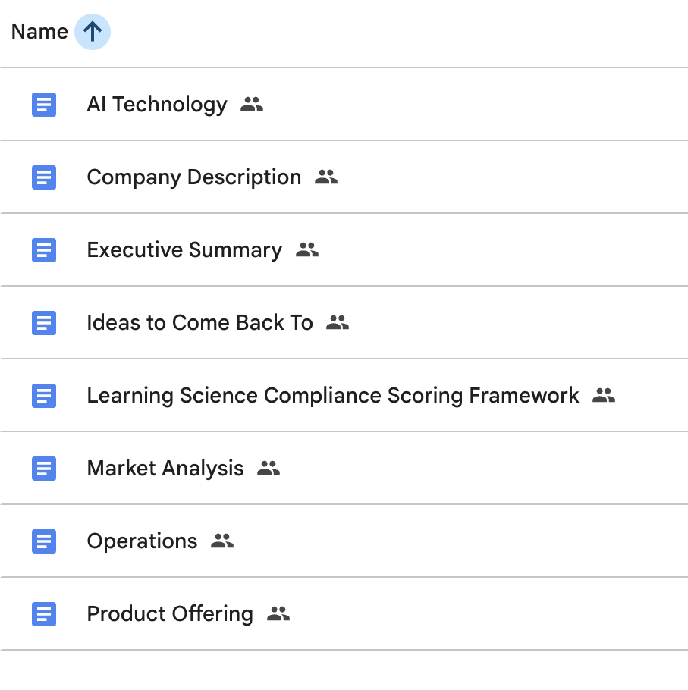
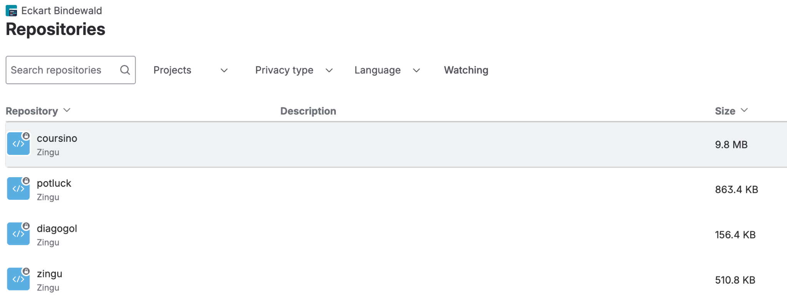
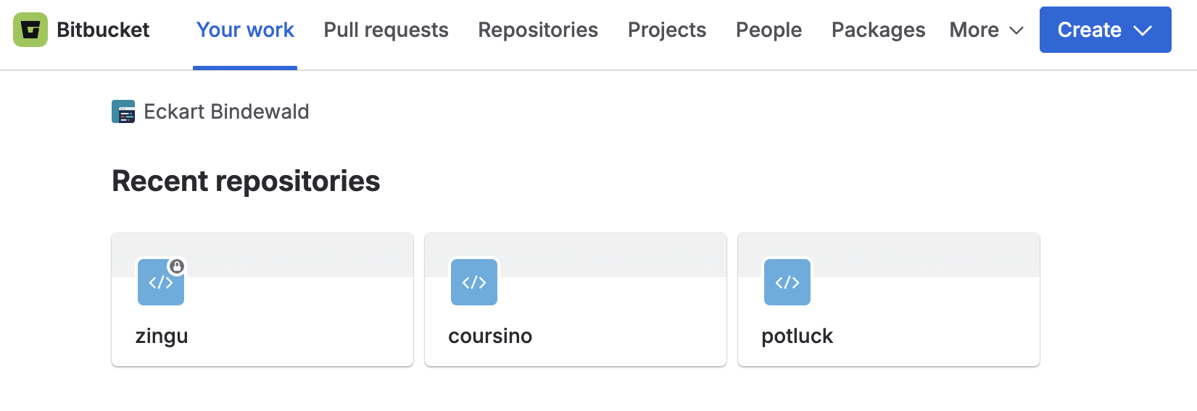
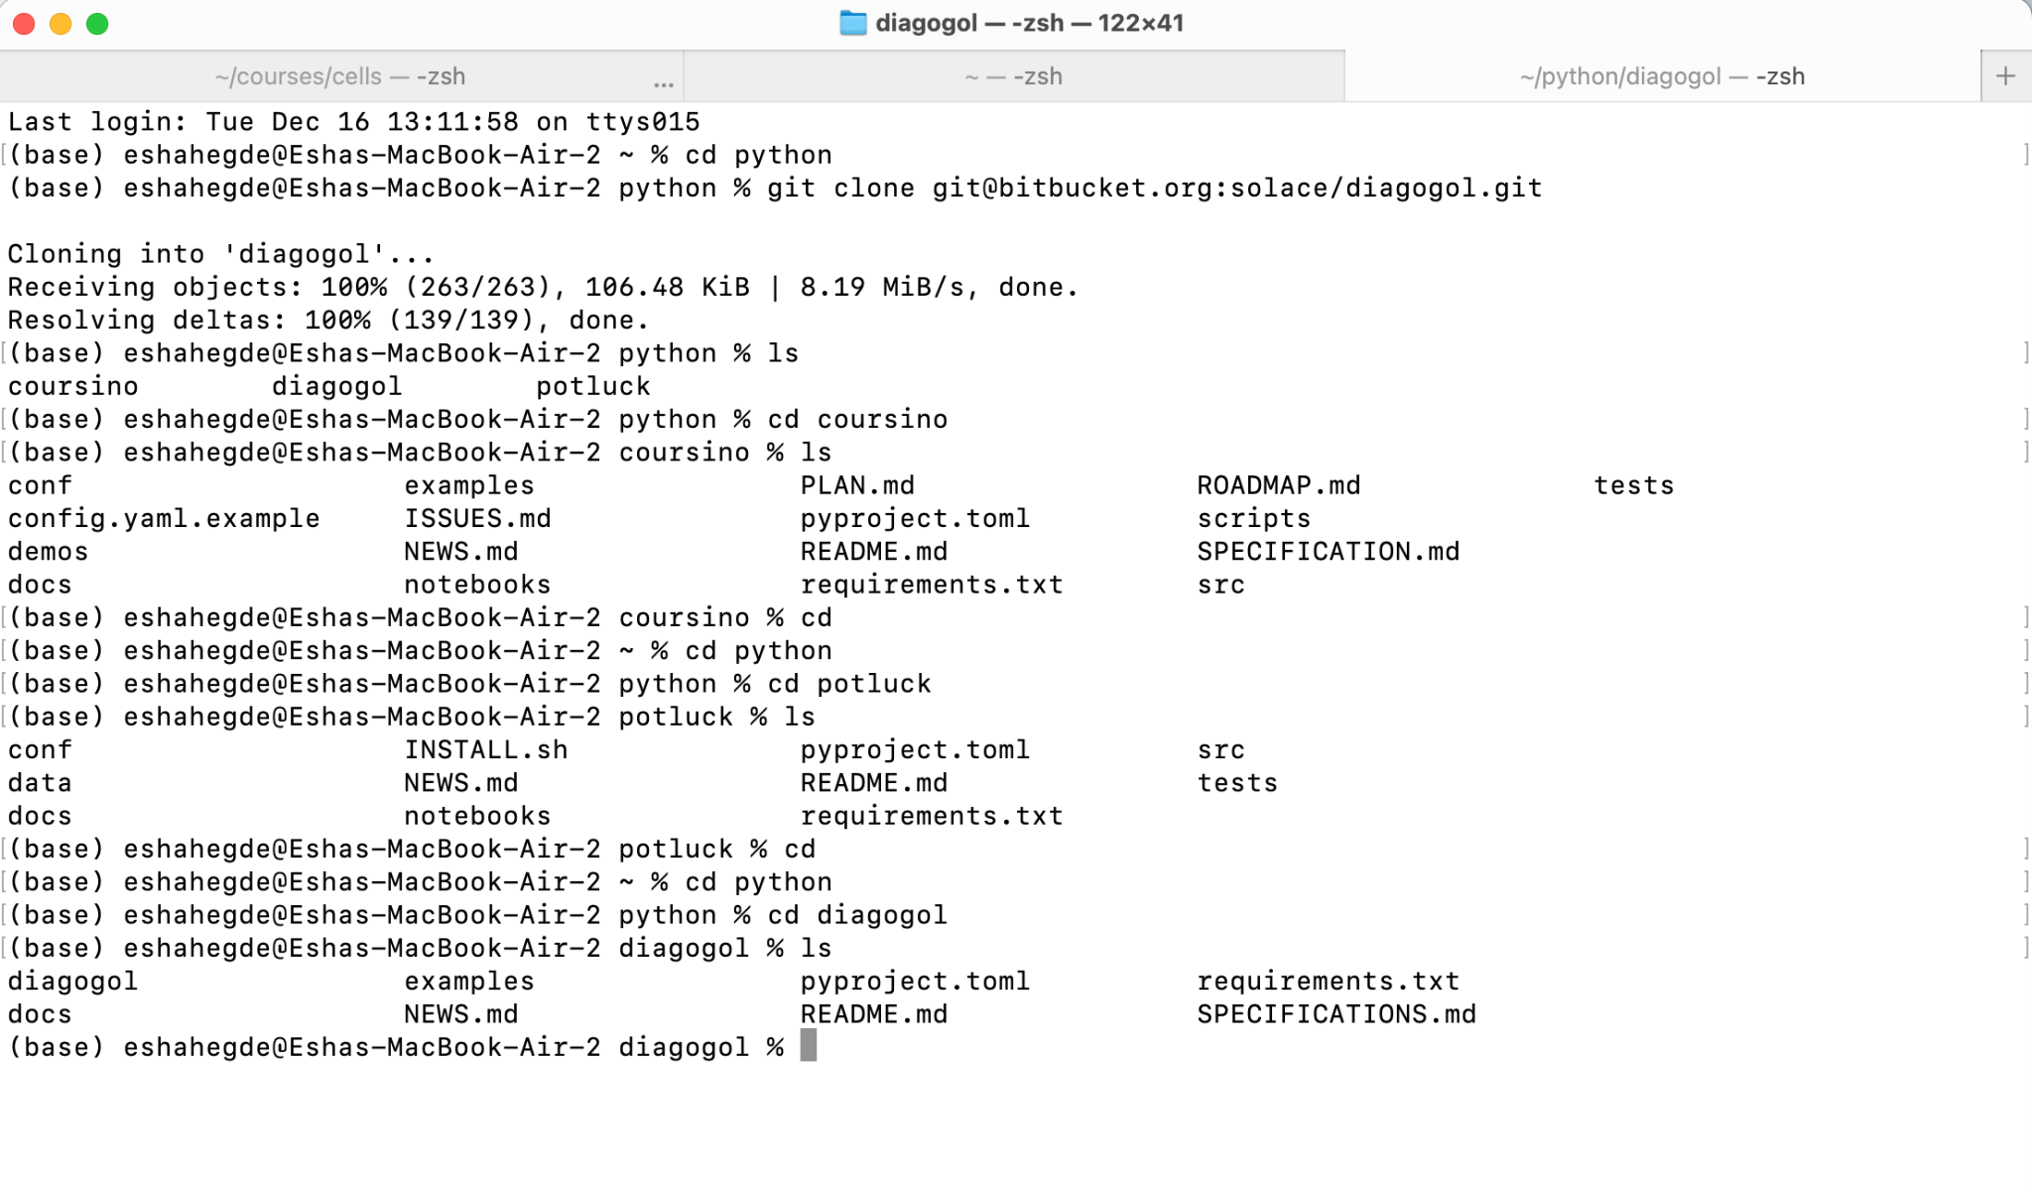
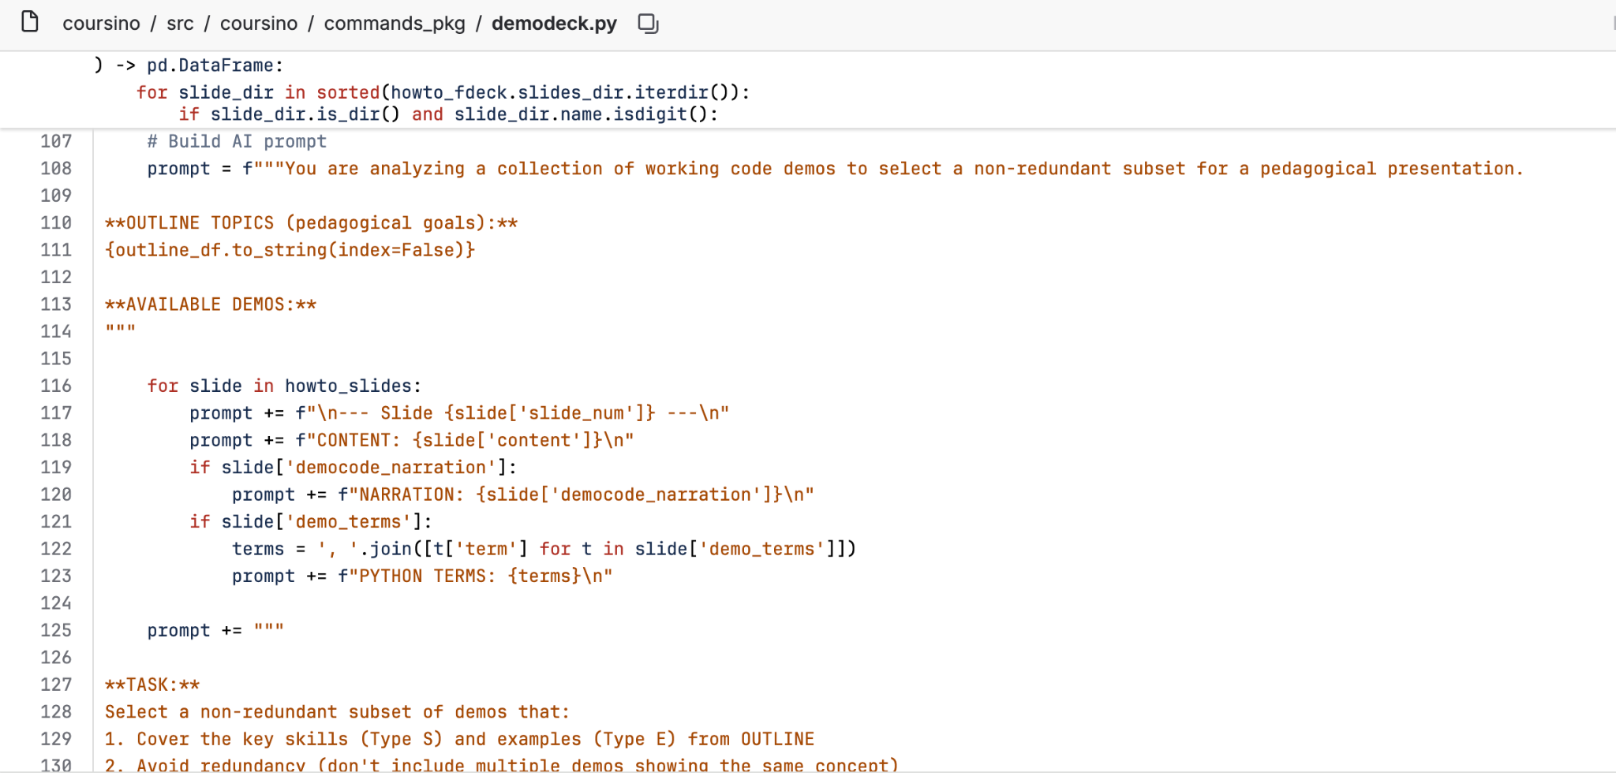
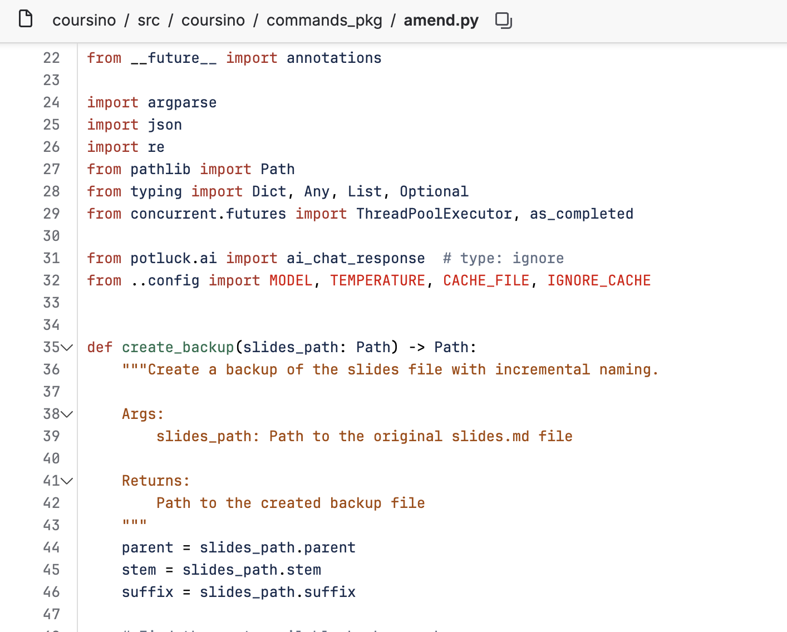

Python Packages - Bitbucket
Process
Business Plan
Idea → Working Program
Revising/Tweaking Code Structure
Installing Locally Through Terminal

Slide 7
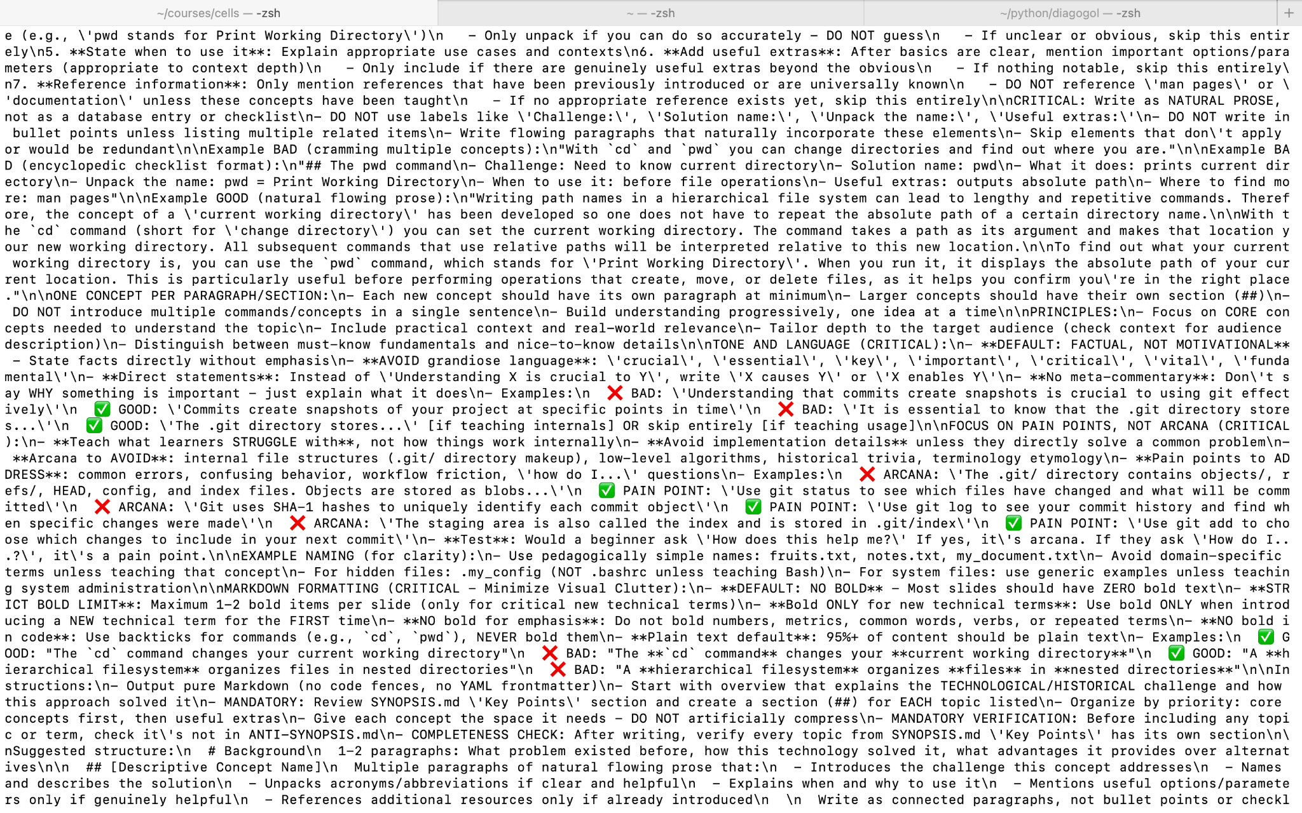

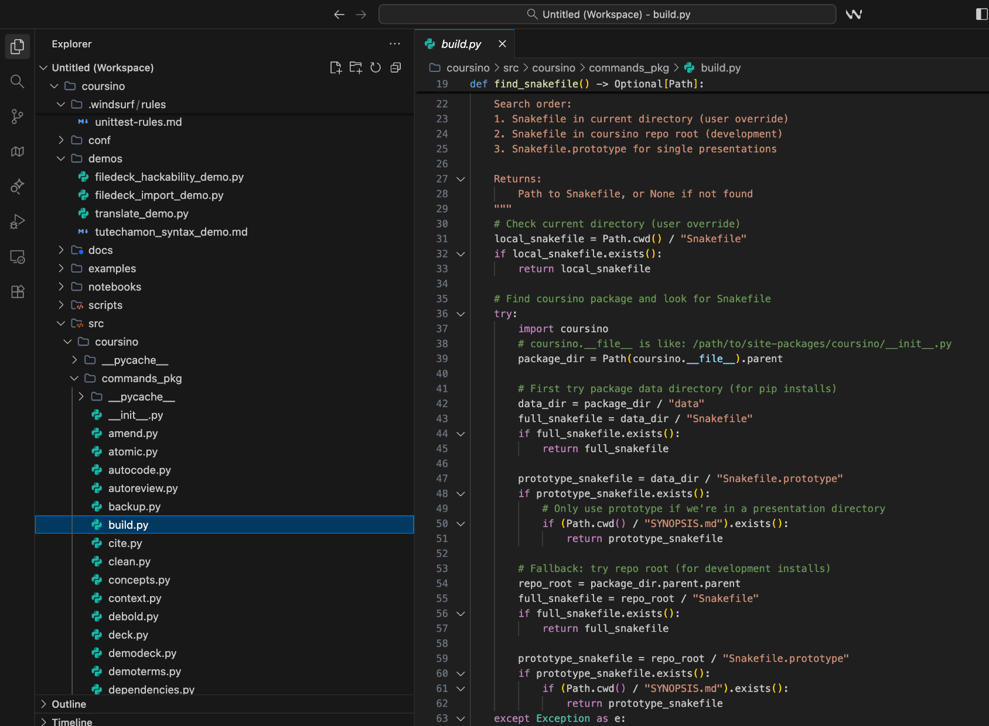
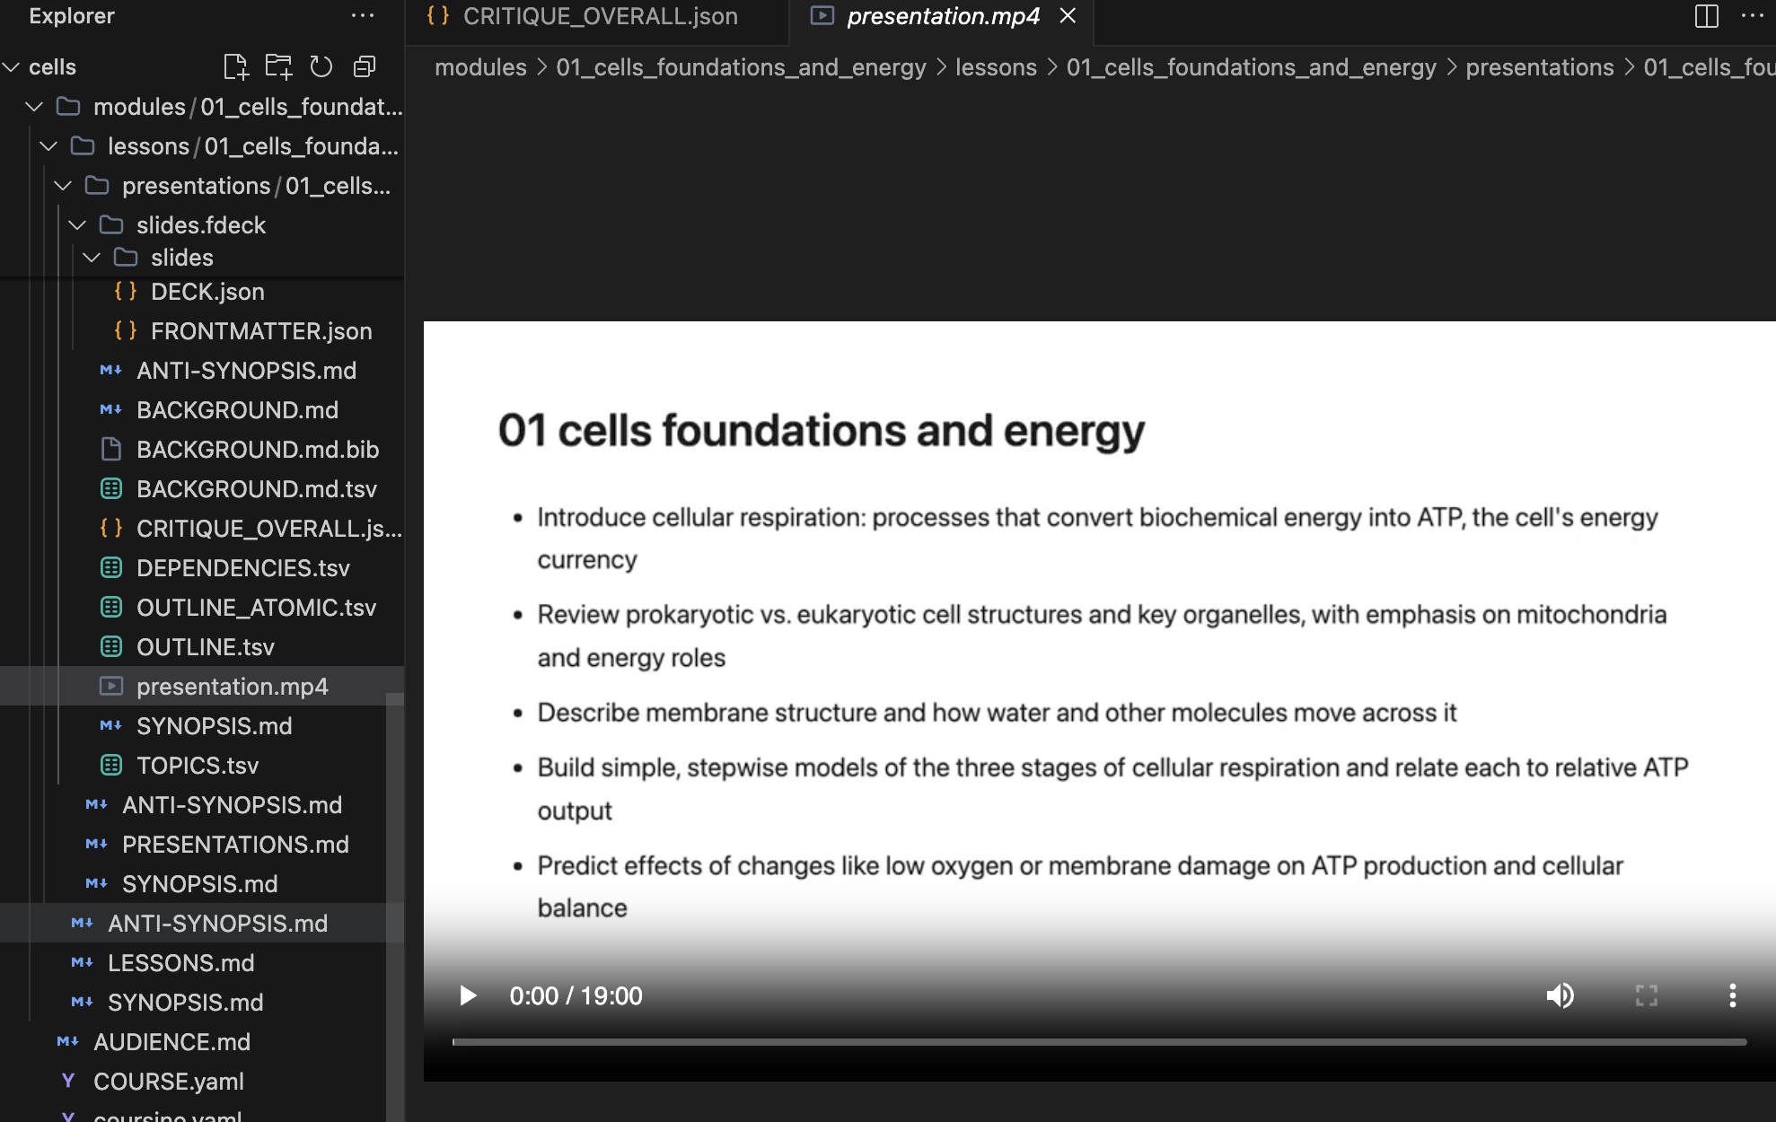
Process
Running/Testing Program - Generation
Folder + Package Structure in Windsurf - IDE Editor

Slide 8

Intern/Mentor Presentation
Example Video Course Generated

Slide 9
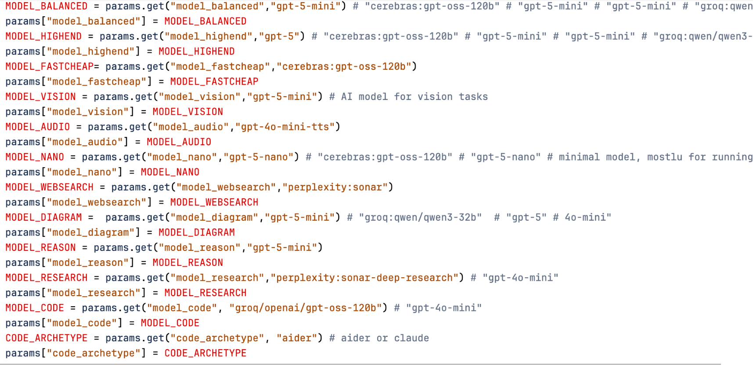
Discoveries So Far
Intern/Mentor Presentation
Volume of Content Generated
Can produce full courses (lessons, quizzes, activities) in minutes/hours vs. days for humans.
Prompt Engineering
The AI program generates content based on user-provided prompts; more detailed and specific prompts result in more focused and high-quality course output.
Model Discrepancies
The AI program generates content based on user-provided prompts; more detailed and specific prompts result in more focused and high-quality course output.
Model Configuration
Time & Effort Comparison
AI significantly reduces production effort, enabling faster iteration vs. human-designed content.

Slide 10
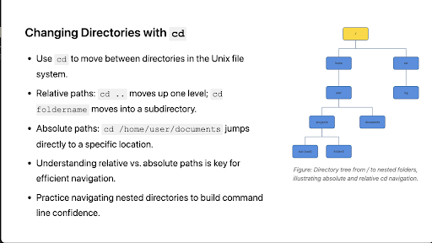
Next Steps
Intern/Mentor Presentation
Software
Business
Finish programming in-house diagram generation package
Revise and finalize course generation software for efficiency and accuracy
Implement software to generate various courses
Bring courses to a user interface domain
Learn more about the business aspect
Test generated courses for instructional alignment and accuracy
Current Diagram Example

Slide 11
Intern/Mentor Presentation
Independent Research
Intern/Mentor
Earn GT credit
Usually 10th grade -- open to all grades!
Design and conduct original research
Opportunity to publish your work
Earn GT credit
College- level research experience
Grades 11 and 12 -- *transportation needed!
Work directly with professional mentor
Gain real-world experience and build your professional network
Ideal if you enjoy independence and exploring your interests!

Slide 12
Thank you!
Questions?

